Slide 1


Price Your Car!
Creating a price estimator for your used vehicle

Slide 2
Data Pre-processing

Slide 3
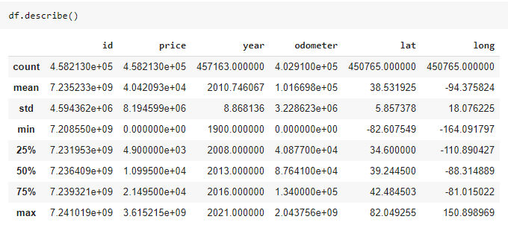
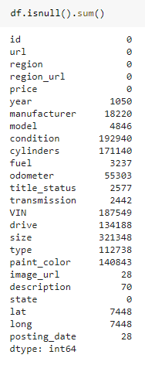
Dataset Quality Check
Invalid inputs (filter)
Price range: $100 - $200,000
Odometer: 10km – 200,000km
NAN values (drop or replace)
Mean values are in different scales (Standard Scaler)

Slide 4
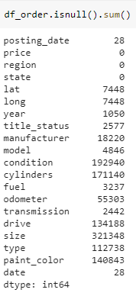
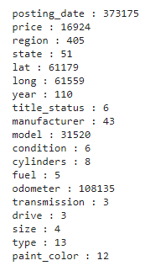
Dataset Transformation
Steps:
1/ Filter out price range and odometer range.
2/ Remove redundant columns.
Check unique values
3/ Check unique values of each column.
Notice: region has 405 unique values and model has 31520 unique values. (increase model complexity)

Slide 5

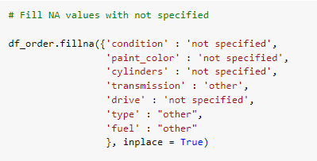
Dataset Transformation
Steps:
4/ Columns in red are important features in determining the price prediction. We drop all rows with NAN values in these columns.
5/ Columns in green, we replaced NAN values with ‘not specified’ or ‘other’ and make it another unique value for each feature. They will be kept in the model.

Slide 6
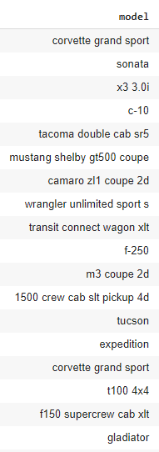



Dataset Transformation
Check unique values
6/ Only take car models that has more than 100 inputs
Reduce complexity of the column by 90x !

Slide 7
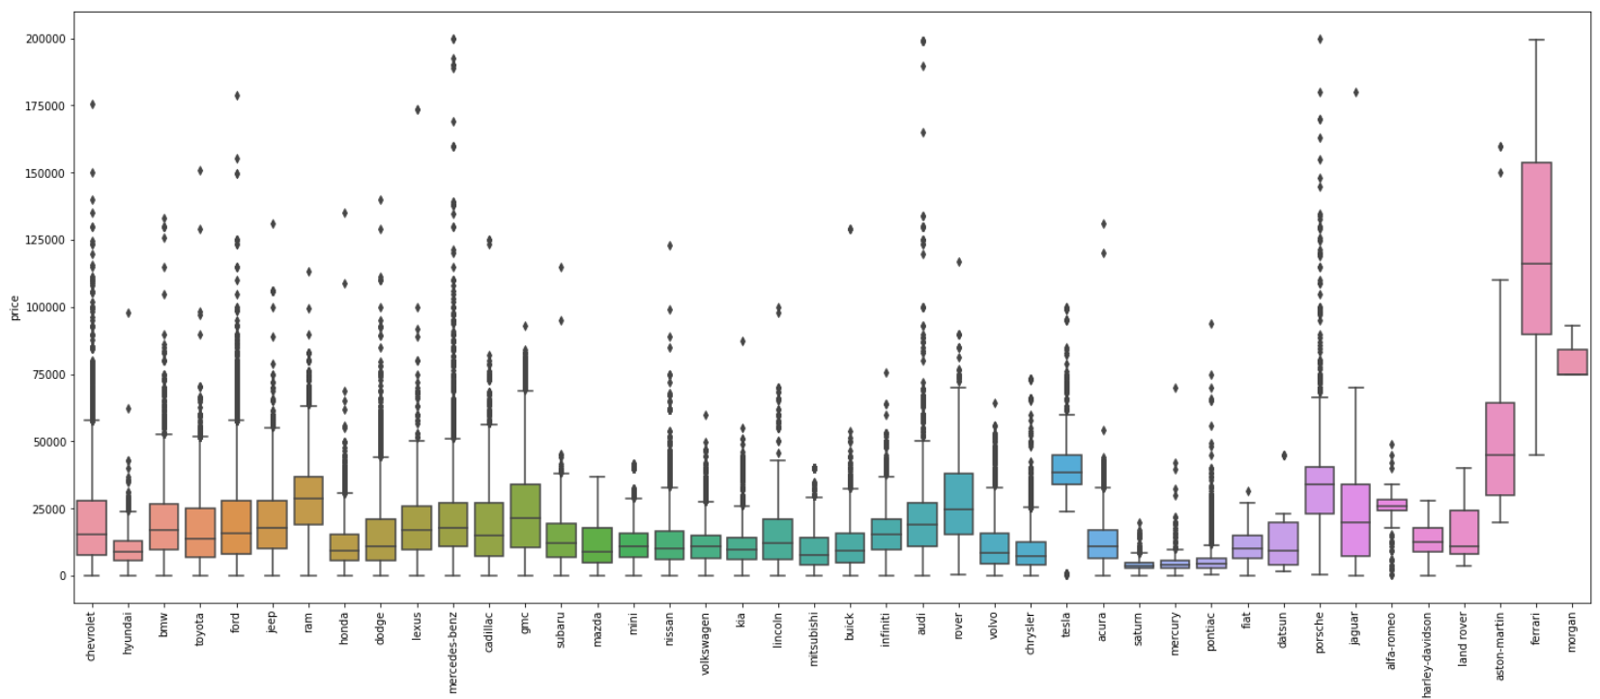
Check Outliers
Price vs. Manufacturer

Slide 8
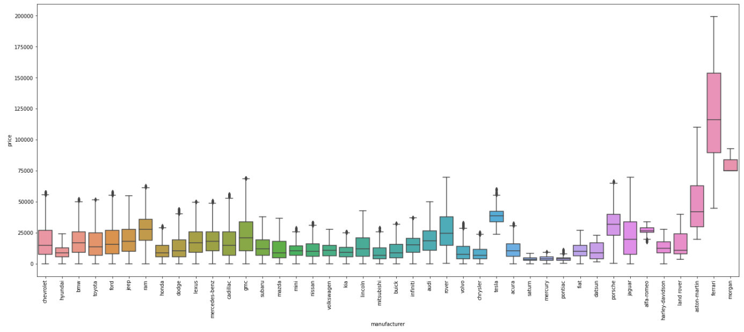
Check Outliers
Price vs. Manufacturer
7/ Remove outliers using interquartile range (IQR)

Slide 9
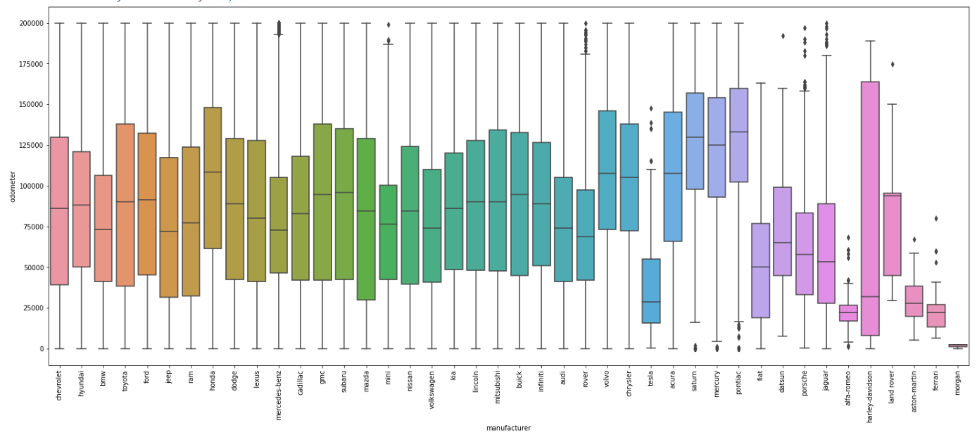
Check Outliers
Odometer vs. Manufacturer

Slide 10
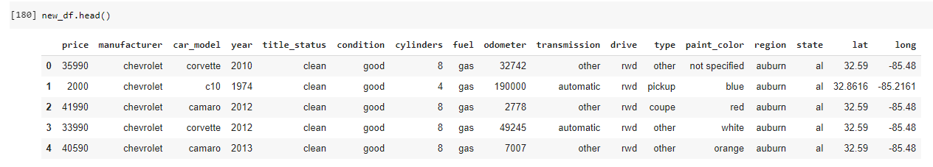
11 Categorical Features
‘target’
5 Numerical Features

Slide 11
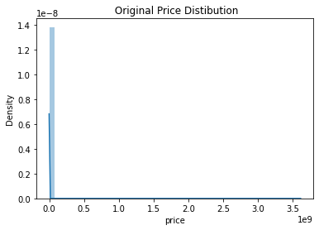
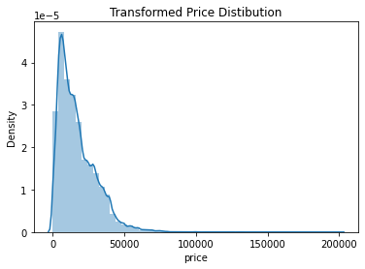
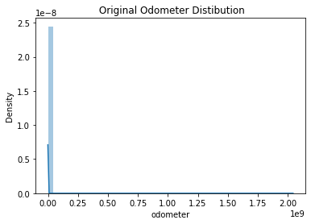
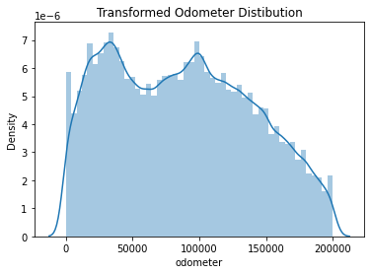
Numerical Features

Slide 12
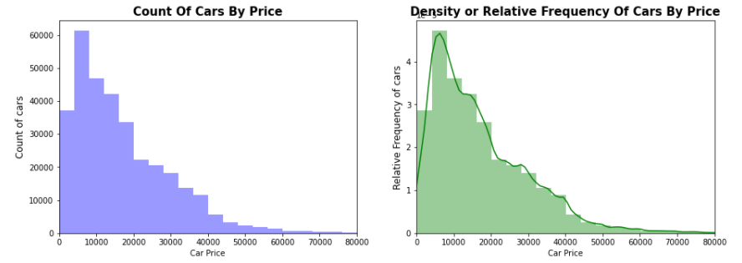
Numerical Features
Majority of cars are prices between $0-$20,000, followed by
$30,000-$40,000 then $40,000+
- More reasonable compared to the original dataset

Slide 13
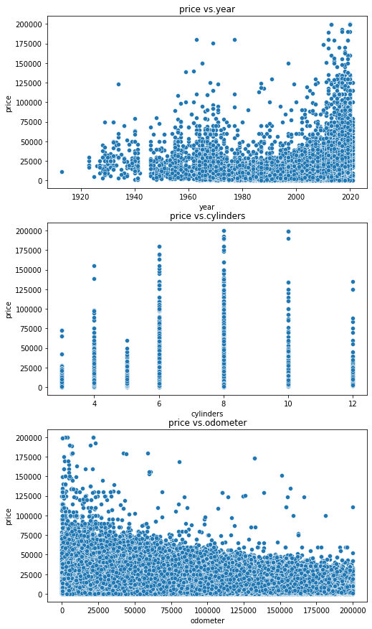
Numerical Features
No linear relation between price and other numerical features.
Do not expect high accuracy with Linear Regression model.

Slide 14
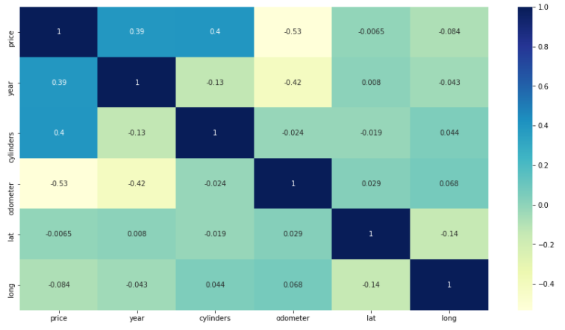
Numerical Features
Price is strongly correlated with Year and Cylinders (higher year and
higher cylinders are priced at higher price)
Cars with higher odometer are priced at lower price.

Slide 15
Categorical Features
11 Categorical Features
‘target’
5 Numerical Features

Slide 16
Feature Engineering
11 Categorical Features
‘target’
351 unique values
Clean, nan
405 unique values
Less impacts on car prices
5 Numerical Features
Again, due to limited computing resources, further drop these columns during data pre-processing step to reduce model complexity.
Reduce from 11 categorical features to 8 features. Get dummies on these remaining features is faster and less computing expensive.

Slide 17
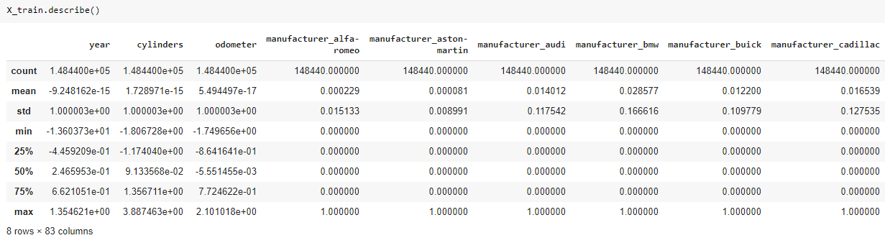
Further Feature Engineering
Apply get_dummies to categorical features
Apply Standard Scaler to numerical features
Split dataset to train (70%) and test (30%)

Slide 18
Algorithms Comparison (Pycaret)

Slide 19
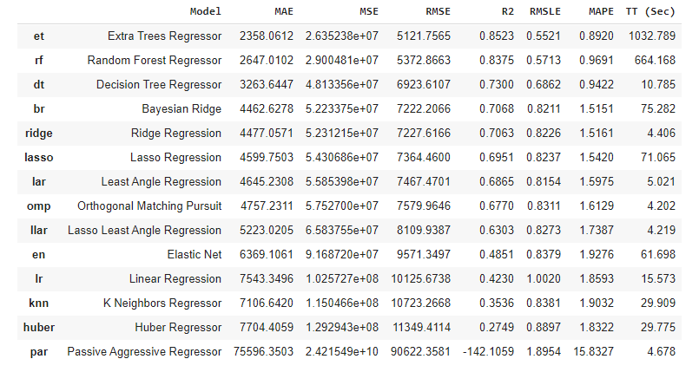
Regression Analysis with Pycaret
With limited computing resources that Colab allows, we only used 30% of the data set to run the model comparison function.
By default, Pycaret automatically split 30% of data for testing, and uses k-fold validation with k = 10.
Based on the results, we can expect that Random Forest Regressor will be a better fit than Linear Regression for our model.

Slide 20
Model Selection
Linear Regression
Random Forest Regression

Slide 21
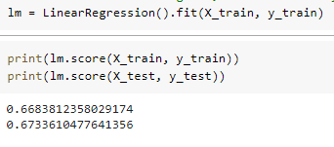
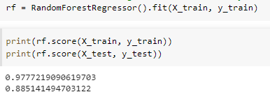
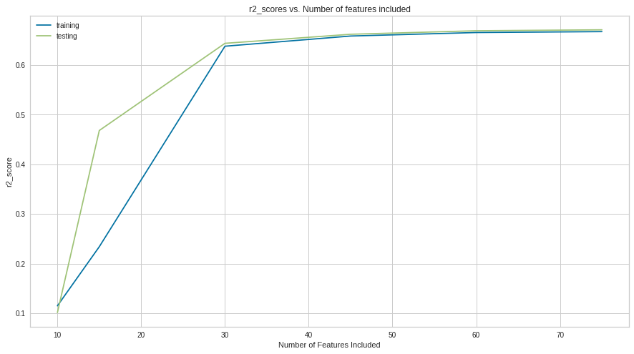
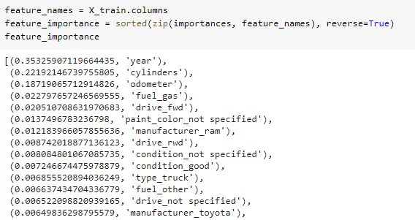
Multi-Linear Regression vs Random Forest Regression
30-40 features to capture 65% of data variance
7 features to capture 85% of data variance

Slide 22
Final Model
Random Forest Regression
With Hyperparameters Tuning

Slide 23
Fill in final model info

Slide 24
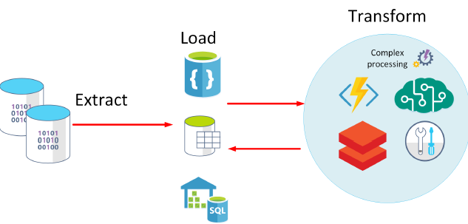
Future Works
When computing resources available, add back ‘model’ column to increase prediction accuracy
Further Feature Engineering Tasks to reduce the model complexity while maintaining accuracy
Perform ELT: load big datafile onto Data Base and use cloud resources to query and perform transformation and load back clean data sets. Right now we are using Google Drive.

